Slide 1
Design and Analysis of Algorithms Lab
Dr. Sujata Joshi

Slide 2
Part B
10
DMART is providing special offer to its customer on New Year’s Eve. Customers can buy anything they want with flat 80% discount, but the products they buy should fit into the basket provided by DMART. The objective is to collect the expensive products which fit into the given basket and overall weight of the basket cannot exceed 15kg. Write an algorithm by using knapsack algorithm using dynamic programming to find the best subset for the given scenario.

Slide 3
Memory Functions
Dynamic programming deals with problems whose solutions satisfy a recurrence relation with overlapping subproblems. The direct top-down approach to finding a solution to such a recurrence leads to an algorithm that solves common subproblems more than once and hence is very inefficient (typically, exponential or worse).
The classic dynamic programming approach, on the other hand, works bottom up: it fills a table with solutions to all smaller subproblems, but each of them is solved only once. An unsatisfying aspect of this approach is that solutions to some of these smaller subproblems are often not necessary for getting a solution to the problem given.
Since this drawback is not present in the top-down approach, it is natural to try to combine the strengths of the top-down and bottom-up approaches. The goal is to get a method that solves only subproblems that are necessary and does so only once. Such a method exists; it is based on using memory functions.
This method solves a given problem in the top-down manner but, in addition, maintains a table of the kind that would have been used by a bottom-up dynamic programming algorithm.
Initially, all the table’s entries are initialized with a special “null” symbol to indicate that they have not yet been calculated. Thereafter, whenever a new value needs to be calculated, the method checks the corresponding entry in the table first: if this entry is not “null,” it is simply retrieved from the table; otherwise, it is computed by the recursive call whose result is then recorded in the table.

Slide 4
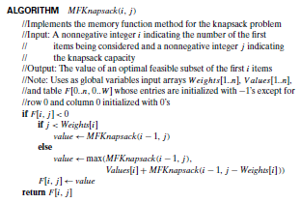

Slide 5
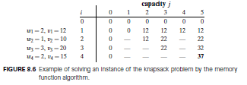

Slide 6

Exercises
Apply the bottom-up dynamic programming algorithm to the following instance of the knapsack problem:

